Slide 1


DATA | MODULE 2
Hypothesis Testifig
Week 5

Slide 2
Table of Contents
Central Limit Theorem
Definition of Hypothesis
Steps in Hypothesis Testing
One Sample T-test
Two Sample T-test
Paired Sample T-test
ANOVA

Slide 3

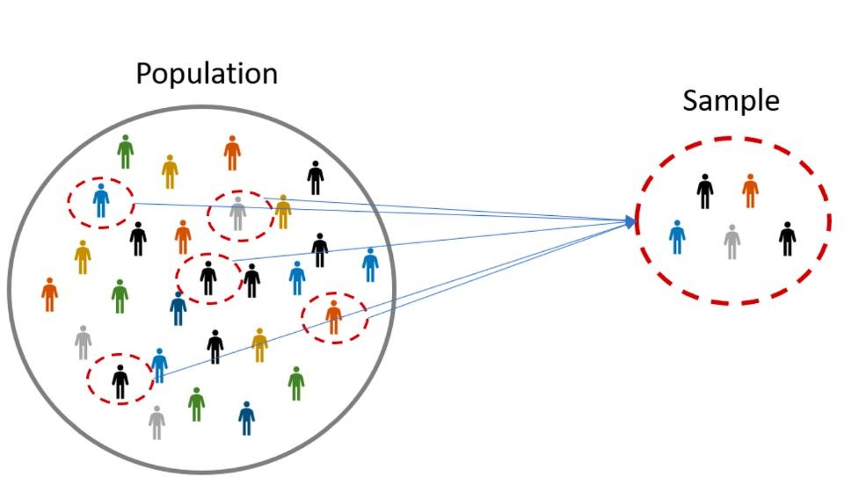



Central Limit Theorem
Imagine that you take samples from a population of people’s heights, and for each sample you calculate their mean.

Slide 4
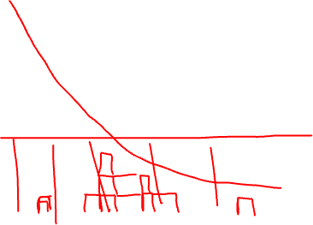
Central Limit Theorem
μ1 = 10
μ1 = 12
μ1 = 9
μ1 = 10
μ1 = 6
μ1 = 12
μ1 = 10
μ1 = 11
μ1 = 11
μ1 = 13
μ1 = 19

Slide 5

Central Limit Theorem
μ1 = 10
μ1 = 12
μ1 = 9
μ1 = 10
μ1 = 6
μ1 = 12
μ1 = 10
μ1 = 11
μ1 = 11
μ1 = 13
μ1 = 19

Slide 6
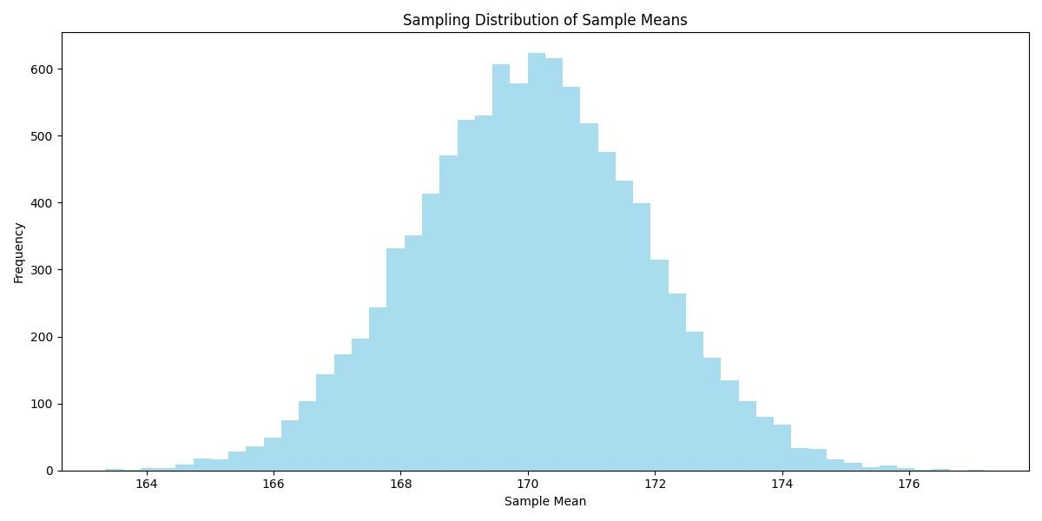
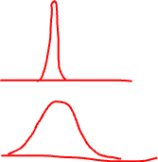

Central Limit Theorem
μ1 = 10
μ1 = 12
μ1 = 9
μ1 = 10
...
...
μ1 = 13
μ1 = 18
μ1 = 19
μ1 = 5
μ1 = 20

Slide 7
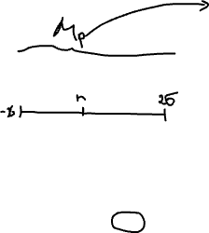
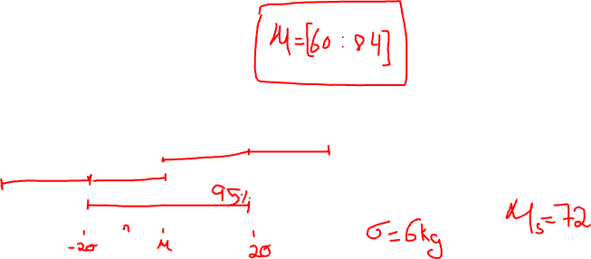
Central Limit Theorem
μ1 = 10
μ1 = 12
μ1 = 9
μ1 = 10
...
...
μ1 = 13
μ1 = 18
μ1 = 19
μ1 = 5
μ1 = 20

Slide 8
Central Limit Theorem
Now, if we plot all sample means, we get a familiar shape, a normal distribution. In other words, the distribution of the means of the sampling distribution tends towards a normal distribution.

Slide 9
Central Limit Theorem
The sampling distribution will consistently tend toward a normal distribution, having its own mean and standard deviation. An essential takeaway is that the mean of the sampling distribution equals the population mean. This is happens regardless of the shape of the population distribution.

Slide 10
Central Limit Theorem
The Central Limit Theorem (CLT) states that, irrespective of the shape of the underlying population, the sampling distribution of the mean will approximate a normal distribution as the sample size grows larger (n > 30), assuming all samples are identical in size and randomly sampled.
Large Sample Size & Individual Data Points: Even with a large sample, the distribution of individual data points could still be non-normal. For instance, a dataset with millions of data points could exhibit significant skewness or extreme kurtosis.
Large Sample Size & Averages of Samples: If you are taking multiple samples from a population and calculating their averages, the distribution of those averages tends to be normal due to the CLT, even if the underlying population is not normal.
Practical Implications: While the CLT is powerful, it's important to remember that many statistical tests and methods assume that the individual data points (not their means) follow a normal distribution. Therefore, having a large dataset doesn't allow you to bypass these assumptions.

Slide 11
Hypothesis Testing

Slide 12
Hypothesis Testing
What if we assume that being inside the lines would be good enough to consider something “valid”?

Slide 13


Hypothesis Testing
The first step in hypothesis testing is formulating a hypothesis, which is a premise or claim that we want to test about a population parameter. The objective of a hypothesis test is to decide, based on a sample from the population, which of two complementary hypotheses is true:
Null Hypothesis
- Currently “accepted” value for a parameter.
Alternative Hypothesis - The alternative hypothesis is a statement asserting an alternative condition or outcome compared to the null hypothesis.

Slide 14

Hypothesis Testing
In a hypothesis testing problem, after observing the sample the experimenter must decide either to accept s as true or to reject .
Let’s see the following example:
If 𝜇 denotes a population parameter, let’s say the change in a patient’s blood pressure after taking a drug, we write:
= 0 versus ≠ 0
The null hypothesis states that, on average, the drug has no effect on blood pressure, and the alternative hypothesis states that there is some effect.

Slide 15

Hypothesis Testing
Some definitions:
Statistical hypothesis testing operates on the principle that while establishing universal truth is challenging, it is possible to demonstrate falsity through the presentation of counterexamples.
The null hypothesis should assert the absence of an effect and explicitly state equalities ( ).

Slide 16
Hypothesis Testing
Some definitions:
Statistical Hypothesis Testing: The practice of making inferences about population parameters by disproving a null hypothesis using sample data.
Null Hypothesis (H₀): A statistical assertion indicating no effect or relationship, represented by equalities ( ).

Slide 17
Hypothesis Testing
Step by step:
After formulating the Null and Alternative Hypothesis we must:
Choose significance level
Collect Data
Calculate Test Statistic
Determine P-value
Decision-making

Slide 18
Hypothesis Testing: Step by Step
Step 1: Pick significance level
The significance level, denoted by 𝛼, is the probability of incorrectly rejecting the null
hypothesis when it is actually true. In other words, how likely is our test findings to yield a wrong conclusion.
Common choices for 𝛼 are 1%, 5% or 10%. This will heavily depend on the nature of the problem studied.

Slide 19
Hypothesis Testing: Step by Step
Step 1: Choose significance level
The significance level, denoted by 𝛼, is the probability of incorrectly rejecting the null
hypothesis when it is, in fact, true. It represents how likely our test is to produce a false positive result.
Common choices for 𝛼 include 1%, 5%, or 10%, and the selection depends on the specific context of the study.

Slide 20
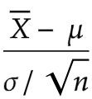
Hypothesis Testing: Step by Step
Step 3: Calculate Test Statistic
The test statistic used to assess the population mean depends on the specific type of test being conducted. In general, when checking for a population mean (μ), the common formula for the test statistic is
hypothesized population mean
sample mean
Std of the population
sample size
The test statistic quantifies how many standard deviations the sample mean is from the hypothesized population mean, aiding in the determination of whether to reject the null hypothesis based on the observed sample data.

Slide 21
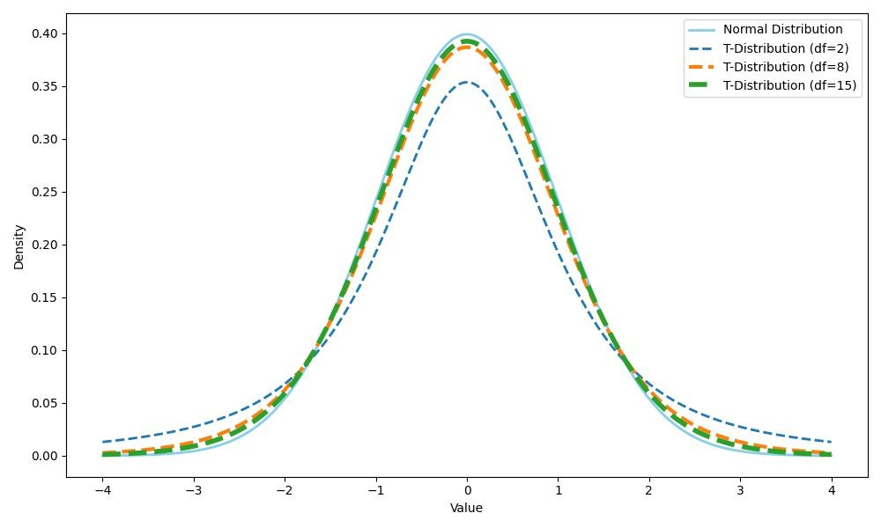

Hypothesis Testing: Step by Step
Step 3: Calculate Test Statistic
When 𝜎 is known, the appropriate test statistic is the z-score. This statistic conforms to a normal distribution.
When 𝜎 is unknown or the number of samples is
<30, the appropriate test statistic is the t-statistic. This statistic conforms to a t-distribution.

Slide 22
Hypothesis Testing
Step 4: Determine P-value
Having obtained a test statistic and considered the distribution of our samples (whether normal or T), we can now evaluate the probability of getting a sample mean as extreme as the one we observed. This probability is known as the p-value.
If the p-value is low, it means that the likelihood of obtaining the observed results, or more extreme results, under is unlikely. This often leads to rejecting the null hypothesis in favor of an alternative hypothesis.

Slide 23
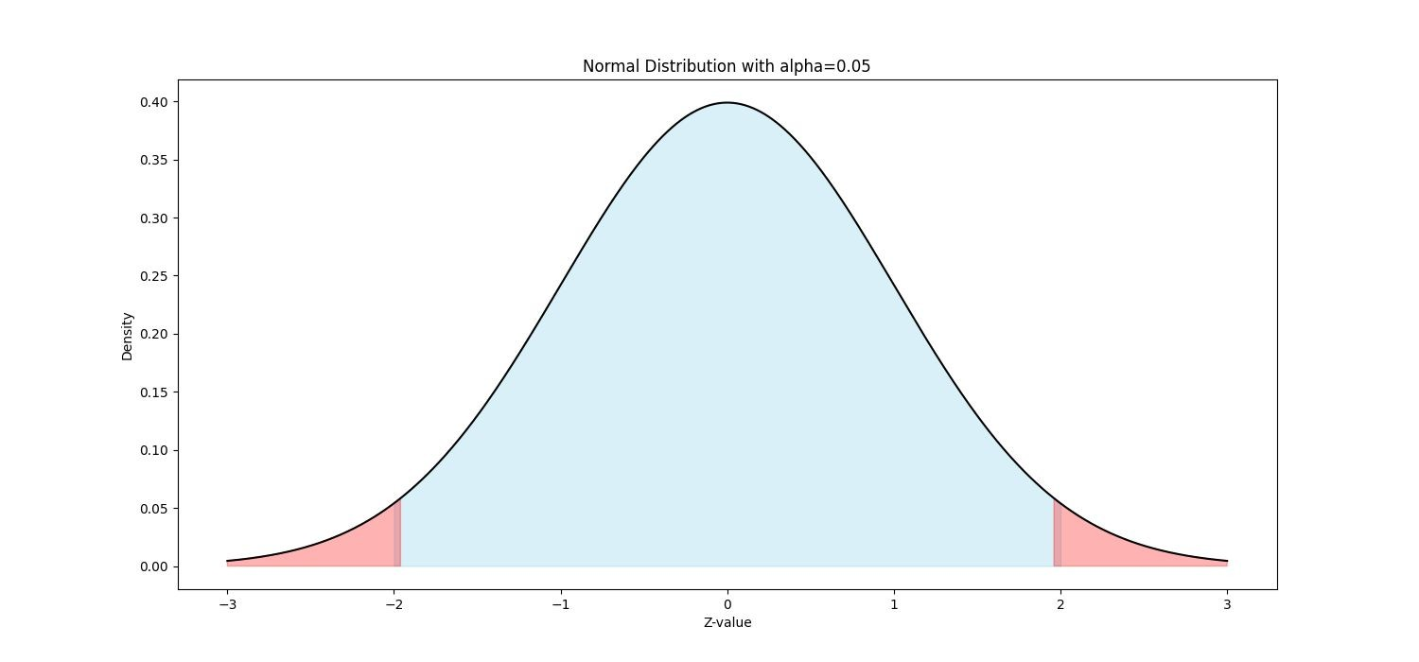

Hypothesis Testing
Step 5: Decision-making
Finally, we need to decide whether to reject
or fail to reject it.
In two-tailed tests (when we test for equalities):
If p_value < 𝛼 we reject the null hypothesis.
If p_value > 𝛼 we fail to reject the null hypothesis.
Reject the null

Slide 24
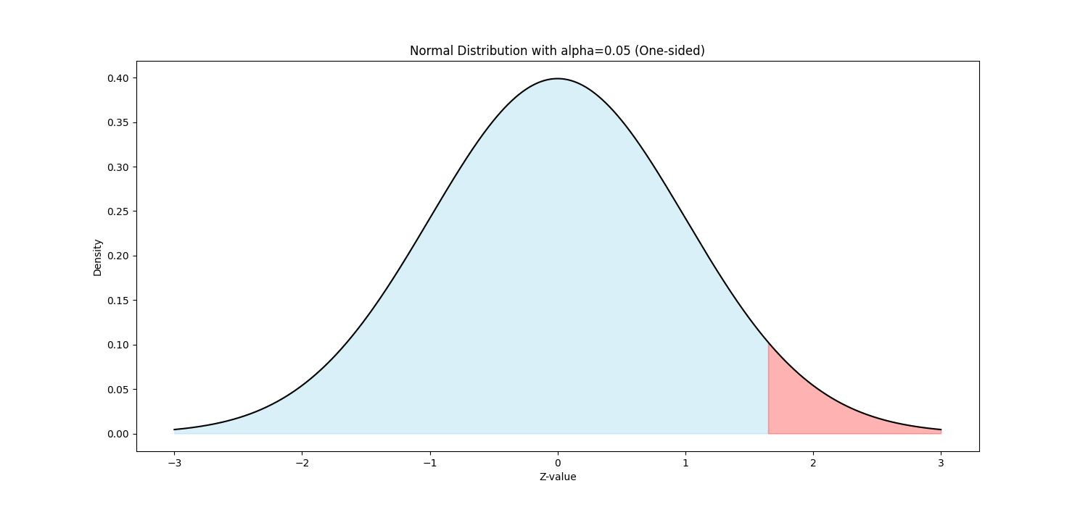
Hypothesis Testing
Step 5: Decision-making
In one-tailed tests (when we test for inequalities):
If p_value < 𝛼 and the test statistic is in the same direction as hypothesis.
If p_value > 𝛼 or the test statistic is in opposite direction as hypothesis.
we reject the null
we fail to reject the null
H₀: μ ≤ k H₁: μ > k
Reject the null

Slide 25



Hypothesis Testing
Different Types of Tests
One Sample T-test
○
in python: ttest_1samp(sample, k, alternative = “two-sided”)
○
in python: ttest_1samp(sample, k, alternative = “greater”)
○
in python: ttest_1samp(sample, k, alternative = “less”)

Slide 26
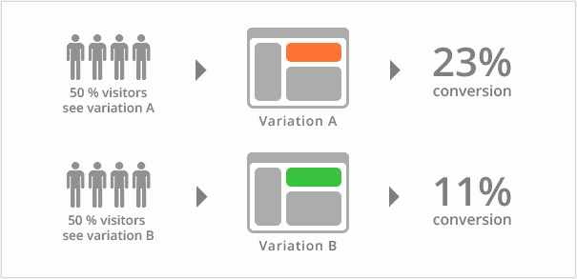



Hypothesis Testing
Different Types of Tests
Two Sample T-test (compares the means of two independent samples)
in python: ttest_ind(sample1, sample2, alternative = “two-sided”)
○
in python: ttest_ind(sample1, sample2, alternative = “greater”)
○
in python: ttest_ind(sample1, sample2, alternative = “less”)

Slide 27
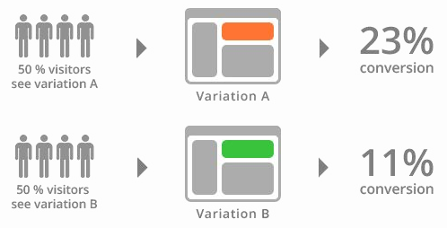
Hypothesis Testing
Different Types of Tests
Two Sample T-test (compares the means of two independent samples)

Slide 28
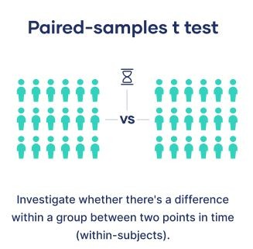
Hypothesis Testing
Different Types of Tests
Paired Sample T-test (compares the means of two dependent samples)
in python: ttest_rel(sample1, sample2, alternative = “two-sided”)
○
in python: ttest_rel(sample1, sample2, alternative = “greater”)
○
in python: ttest_rel(sample1, sample2, alternative = “less”)

Slide 29
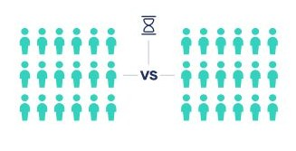
Hypothesis Testing
Different Types of Tests
Paired Sample T-test (compares the means of two dependent samples)
Investigate whether there’s a difference within a group between two points in time
(within-subjects)

Slide 30

Hypothesis Testing
Different Types of Tests
ANOVA (compares the means of multiple independent samples)
in python: f_oneway(sample_1, sample_2, sample_3, …, sample_n)

Slide 31
Summary
Hypothesis Testing:
- Create H0 and H1
- Pick a significance level: how confortable are we in being wrong
- Test Statics + get the pvalue
- If the pvalue is too smal, I reject H0

Slide 32
Lets see this in Python, while following slides?

Slide 33

RUNNING EXAMPLE
Let’s take our Titanic dataset. You have seen that the prices in first class were on average 85 dollars and someone told you that prices in 3rd class were usually a fifth of prices in first class. You are skeptical. Set up the hypotheses to test this.
Now, you think the prices in third class are even cheaper than that. Set up the hypotheses to test this.

Slide 34
THE 5 STEPS OF HYPOTHESIS TESTING
Set the hypothesis
Choose significance / confidence level
Sample
Compute statistic + Get p-value
Decide

Slide 35
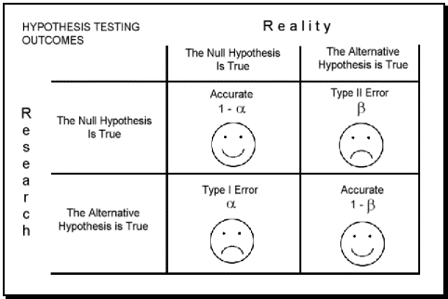
SIGNIFICANCE AND TYPES OF ERRORS
We said that we would make our decision to reject the null when it strains credibility yo maintain it. But how do we measure this? We set a significance level 𝝰 à priori.
Significance is the probability of rejecting the null if it happens to be true. This is the most damaging type of error so we should be demanding with our significance (𝝰 chosen at most 5%, usually)
We have seen that significance is the converse of confidence (1-𝝰).

Slide 36
RUNNING EXAMPLE
Let’s pick a significance level. Are you feeling confident about our claim or not?

Slide 37
THE 5 STEPS OF HYPOTHESIS TESTING
Set the hypothesis
Choose significance / confidence level
Sample
Compute statistic + Get p-value
Decide

Slide 38
RUNNING EXAMPLE
Open the class Jupyter.
Let’s assume we have access to only 30 3rd class passengers (say, to get the price paid for the ticket you had to track down their families to send you a copy of the receipt).
Sample your dataset for 30 entries

Slide 39
THE 5 STEPS OF HYPOTHESIS TESTING
Set the hypothesis
Choose significance / confidence level
Sample
Compute statistic + Get p-value
Decide

Slide 40
COMPUTE YOUR TEST STATISTIC
Your test statistic depends on what kind of test you are trying to make.
For each test, there is a formula that takes the circumstances of your observation and returns a number that is as high as it is unlikely that your observation came from H₀.
In the case of trying to infer the average of a population the relevant circumstances to consider are:
The observed mean
How much the samples vary from each other
The number of observations sampled

Slide 41
GET THE P-VALUE
We said the statistic is higher the more unlikely it is for your sample to be sampled under H₀, but how can we quantify that?
We use the statistic to check how likely is it to get a sample mean as extreme as the one we actually sampled.
This quantity is called the p-value
If the p-value is very small, it means that it is extremely unlikely, under H₀, to get a result like the one we did in our sample and thus we should reject H₀, because staying with it strains credibility.
We compute the p-value from a table and the value of our statistic or, because it’s 2020, from a scipy call.
one-tailed
two-tailed
st.ttest_1samp(sample,H0)
st.ttest_1samp(sample,H0,alternative='less')

Slide 42
RUNNING EXAMPLE
Get the p-value for your test statistic
Watch out, the way to compute p-values for each of our hypotheses is actually different

Slide 43
THE 5 STEPS OF HYPOTHESIS TESTING
Set the hypothesis
Choose significance / confidence level
Sample
Compute statistic + Get p-value
Decide

Slide 44
DECISION CRITERIA
We now compare our obtained p-value (chance to see an observation at least as extreme as the one we saw) with our significance level .
If p<𝝰, we have just witnessed an event that, if H₀ is true, happens less than a fraction 𝝰 of the times. This strains credibility and we therefore reject H₀
If p≥𝝰, we have witnessed an event that, if H₀ is true, happens more than a fraction 𝝰 of the times. This is not enough to convince us to change our minds about H₀ and thus we do not reject it
Word of warning: in single sided tests, your test statistic needs to “go against” H₀ for you to reject it. E.g. If H₀ posits that average weights are lower than 50 and your observation is below 50kg, you can’t reject, even if the p value is smaller than 𝝰

Slide 45
RUNNING EXAMPLE
Make a decision on whether you reject that
prices in 3rd class were usually a fifth of prices in first class
prices in third class are a fifth of prices in first class or more expensive

